Slide 1


Conversational Web Browsing
This cover has been designed using resources from Freepik.com
What can I do in this Website?
Turning interactions with websites in natural-language dialogs

Slide 2
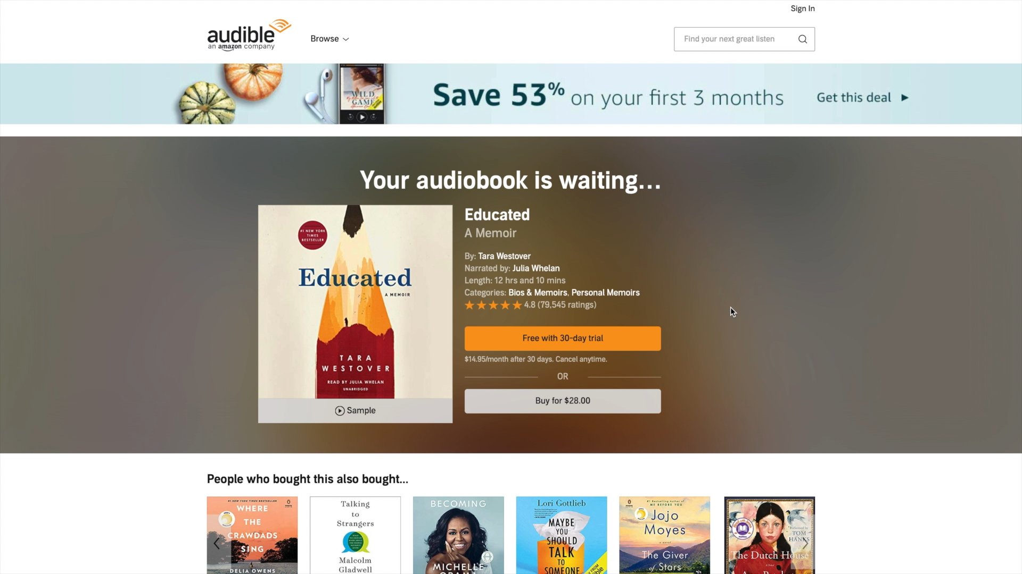
What’s happening here is that we come with a task in mind and use the features and structure of the website, which are built around a set of principles that optimise such visual tasks
The Web today
Notes:
The first question here is why do we need a new paradigm? What’s wrong with how we browse the web today.
Well, the web has evolved over time to accommodate to new type of devices and scenarios, but still remains a visual experience.
When we come to this website and we are looking for reviews, we simply scroll down until we find what we are looking for and that’s it.
What’s happening here is that we come with a task in mind and use the features and structure of the website, which are built around a set of principles optimise such visual tasks, so that we can accomplish our goals.
This doesn’t translate well to other type of users and scenarios.
For example Blind and visually impaired users browse the web, normally by using a screen reader.
And the experience is totally different.

Slide 3
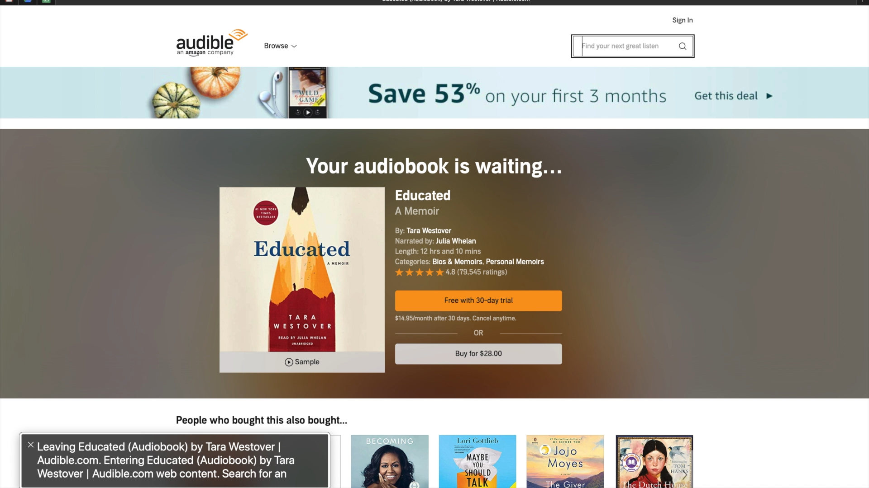
Screen readers essentially sequentially go through all the components and read out the text or type of components, and the users interact with keyboard, shortcuts, or touch gestures to navigate.
So essentially, blind and visually impaired users interact at this low level, in terms of the structure and state of the navigation of visual elements.
Blind and Visually Impaired (BVIP)
Notes:
These screen readers essentially sequentially go through all the components and read out the text or type of components, and the users interact with keyboard, shortcuts, or touch gestures to navigate.
So for the same task, the experience will be something like this:
So essentially, blind and visually impaired users interact at this low level, in terms of the structure and state of the navigation.
The experience is just not the same.

Slide 4

Contextual situations can also limit regular users and their abilities to interact with computer systems.
Situational Impairments
Notes:
Regular users can also experience issues in browsing the web in scenarios where they are challenged by what is called “situational impairments”.
Contextual situations limit our abilities and our senses and so our abilities to interact.

Slide 5
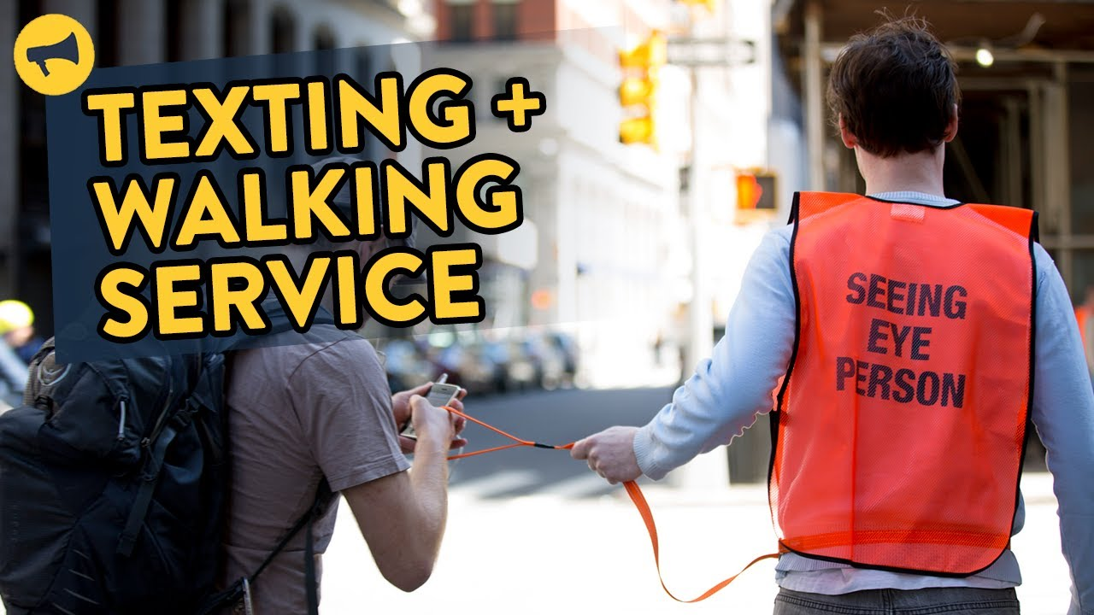
Sometimes even falling into public safety issues
Situational Impairments
Notes:
and here we even fall into public safety issues
And what we are proposing here is a departure from this traditional method of interaction that requires users to translate their goals into low-level actions in a GUI to allow them to express directly their goals.

Slide 6
And what we are proposing here is a departure from this traditional method of interaction that requires users to translate their goals into low-level actions in a GUI
Notes:
So what we are building on is on

Slide 7
A new interaction paradigm for the Web that allows
users to access websites by directly expressing their goals in dialog-based interactions with a conversational agent.
Notes:
So what we are building on is on

Slide 8
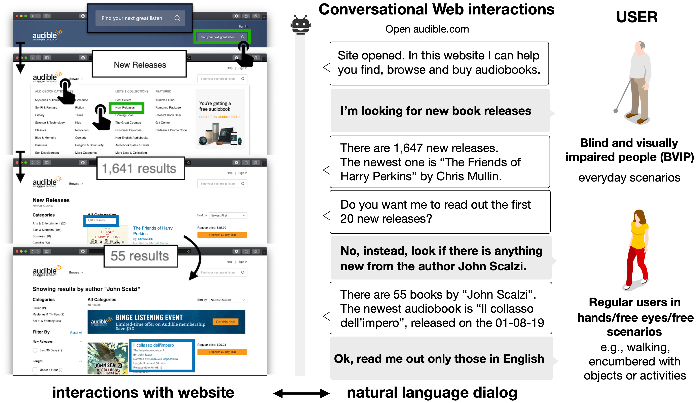
Notes:
Let me illustrate this with an example.
We have our user, that’s browsing the Audible website.
At this point the user can express the request in natural language “I’m looking for new book releases”
The system then should first:
interpret the so called “intent” of the user (what the user is trying to accomplish)
perform the appropriate browsing actions, and information extraction, in order to elaborate a response
And so the navigation would continue.
So this is the vision. And in the middle we have the conversational agent that could be Alexa, or a stand-alone app or service.

Slide 9
Conversational Web Browsing
Baez, M., Daniel, F., & Casati, F. (2019, November). Conversational web interaction: proposal of a dialog-based natural language interaction paradigm for the web. In International Workshop on Chatbot Research and Design (pp. 94-110). Springer, Cham.

Slide 10
Research Threads
How do we design effective conversational access to the Web?
Effective design patterns, guidelines, and empirical evidence of the impact of this new paradigm
How can we turn webpages into dialogs with a user?
Concepts, techniques, algorithms and extensions to the technical specifications
Notes:
This idea opens up a lot of interesting challenges. And the way we are going about it is by addressing two equally important questions?
Of course, putting the human at the centre.
How do we design effective conversational access to the Web?
We are talking about a new way of interacting with the Web, so we need to understand what are effective design patterns, guidelines for designing such experiences. But also trying to answer very basic questions, such as if this paradigm brings value to users, in what scenarios, and in what form.
How can we turn webpages into dialogs with a user?
And the second one is a more technical question, into approaches to turn webpages into dialogs with a user.
And here we are talking about
but also extensions to technical specifications so that the HTML can serve not only graphical interfaces but also conversational interfaces.

Slide 11

Human
We are focusing on Blind and Visually impaired users, and for this we are collaborating with UICI. Which is Italian association for the blind and visually impaired.
Phone photo created by freepik - www.freepik.com
Notes:
I wanted to start from the Human, and more specifically the work we have been doing in the last months with our colleagues and students at POLIMI.
We are focusing on Blind and Visually impaired users, and for this we are collaborating with UICI. Which is Italian association for the blind and visually impaired.
And they are helping us a lot, not only with their individual experiences, but also helping us understand
how to better carry out some of the research activities with the blind and visually impaired population
help us with the recruitment of participants
We are planning in general to run
- structured interviews
large scale survey
concept development and validation focus groups
user studies with prototypes
And indeed, what we have been doing with them in this phase

Slide 12
Understanding Needs and Challenges
Starting from opportunities and barriers of accessing digital services through different type of technologies that are available to BVIP
Notes:
trying to understand the need and challenges of this population.
Focusing on opportunities and barriers of accessing digital services through different type of technologies that are available to BVIP

Slide 13
Accessing digital services
Screen readers
Braille keyboards / display
Conversational Agents
Image Sources
https://www.smashingmagazine.com/2018/12/voiceover-screen-reader-web-apps/
https://visually-impaired-screen-reader-for-mac.peatix.com/
Notes:
Different software and hardware support that help user navigate services - through different modalities.
audio
tactile
general-purpose devices and software, personal assistants and smart speakers.

Slide 14
Preliminary Observations
Accessibility != Usability
Incorporating accessibility tags does not necessarily make websites usable.
Building mental maps takes effort
Part of the process into navigating new websites. This requires users exploring the website, deriving navigation strategies
From Websites to Apps to Personal assistants
Users engage in usage patterns and fallback mechanisms that involve going from Websites (less usable but richer in terms of services) to Apps to Personal assistants (more usable but poorer in terms of services)
Notes:
At this point we are still collecting information, but I wanted to give you some preliminary insights into what we are learning.
It's quite obvious that if a service is not accessible it poses a huge barrier to BVIP users. However,
Incorporating accessibility tags does not necessarily make websites usable. And this was stressed explicitly and implicitly the participants. And interestingly, the examples that will come up often were about the website of public administration.
Everything is there and annotated, but if i need to find something is a different story.
This observations mirrors previous studies stating that “accessibility” is just half of the story.
Then, regardless of whether is accessible / usable or not.
Part of the process of navigating new websites requires users to build a mental map of what the website offers. And for BVIP this requires exploring the website, deriving navigation strategies.
This is not always reusable. If we navigated enough news website we already learn a “familiar” navigation pattern, but this does not seem to be the case for non visual browsing.
These users are very loyal to the services /apps they know..
That’s why services being “stable” is a good quality for them.
Another interesting aspect is how user leverage the various technologies for accessing digital services.
There appear to be this continuum in the usage pattern that goes from Websites to Apps to Personal Assistants.
Users engage in usage patterns and fallback mechanisms that involve going from Websites (less usable but richer in terms of services) to Apps to Personal assistants (more usable but poorer in terms of services)
Gravitating towards apps when available as they have the experience more optimised and are still feature-rich. Big brand apps are push.
Websites usually serve more for information access, or for services not available or not feature complete (in mobile)
Conversational agents, great at home and quick access to services but as we’ll see lacking in terms of services.

Slide 15
Preliminary Observations
Big barriers to ubiquity of services
Using digital services from everywhere is challenging, as they impose different interaction styles, different screen readers, with little reuse of knowledge
Conversational agents very useful, yet limited
Useful for at home automation, quick access to services (mobile) but limited in terms of availability of services, natural language comprehension, operability and personalisation
Making peace with AI limitations, if it brings value
Privacy concerns, limitations in NLU, services. This makes people find ways to adapt to technology, as the benefits outweigh the limitations.
Notes:
Using digital services from everywhere is challenging, as they impose different interaction styles, different screen readers, with little reuse of knowledge
This idea that you can use digital services from everywhere. You start with the desktop, on the go, then at work, from everywhere…
restricted to your own devices
One user told us that he keeps the installation and personalisation of his preferred screen reader in a USB stick, and he takes it everywhere.
Participants expressed it being Useful for at home automation, casual use and leisure (cooking, music)
quick access to services (mobile) but limited in terms of availability of services, natural language comprehension, control and personalisation of the interactions
Which takes us to the last point.
Privacy concerns, limitations in NLU, services. This makes people find ways to adapt to technology, as the benefits outweigh the limitations.
To this point some participants will say that e.g., problems in understanding happen because they “didn’t express themselves properly”. And even defend technology.
This are some interesting points that I wanted to highlight with you.
What we learned about the struggles and frustrations of BVIP so far, can be perhaps better summarised in the following comment by one of the participants.

Slide 16
“
Vorrei che la grafica non fosse una barriera della navigazione. La grafica non mi interessa…
”
I’d like the graphical interface not to be a barrier to browsing the Web. Graphical interfaces bring no value to me
Graphical interfaces bring no value to the BVIP
so why should it be the centre of their experience?
Notes:
paraphrasing
The graphical interface should not be a barrier to them in browsing the Web. Graphical interfaces bring no value to them
and why should it be the centre of their experience?

Slide 17
Deconstructing conversational support
Notes:
I wanted to quickly go over some of our the ideas in terms of the type of support that should be provide to BVIP, as derived from the literature as well as our own experience.

Slide 18
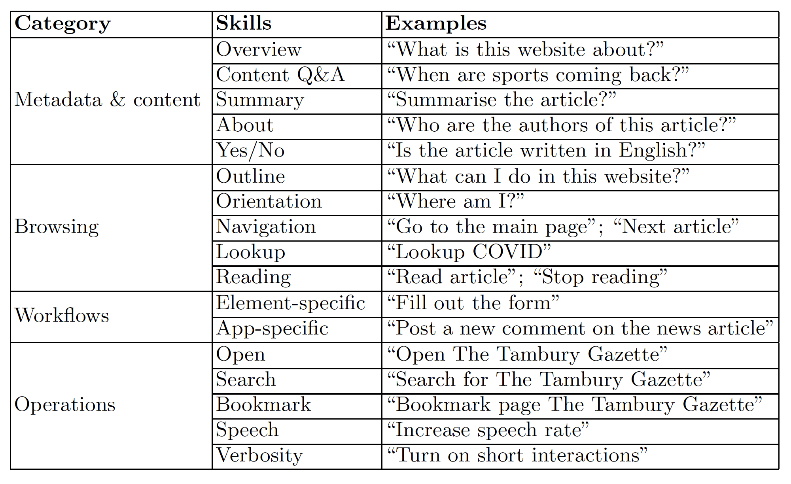
Conversational support
Pina, Alessandro, Marcos Baez, and Florian Daniel. "Bringing Cognitive Augmentation to Web Browsing Accessibility." arXiv preprint arXiv:2012.03743 (2020).
Notes:
We identified a set of categories of support and skills to be supported by the chatbot. Let me go though them

Slide 19
1
Conversational browsing
BVIP should be allowed to explore and navigate the website using natural language, so as to support more traditional information seeking tasks.
Main
Politics
Local
World
Sports
Outline
What can I do in this website?
Orientation
Where am I?
Featured
Tambury matches postponed indefinitely
New vaccine in development for COVID-19
The local boy who plays instruments in a unique way
Navigation
Go to the main page
Lookup
Lookup COVID
Main
Politics
Local
World
Sports
Tambury matches postponed indefinitely
Reading
Read article; stop reading
Due to the recent COVID development, all the football matches are postponed indefinitely.
Notes:
First, Conversational browsing, which is essentially what we saw in the previous example.
BVIP should be allowed to explore and navigate the artefacts using natural language, so as to support more traditional information seeking tasks.
The idea is to improve on the navigation provided by traditional screen readers, which often require learning complex shortcuts and
lower level knowledge about the structure of artefact (a mental picture)
This category of support is inspired by the work in Web accessibility, in using spoken commands to interact with non visual web browsers and conversational search, non visual scanning and skimming.
Tasks that are rather poorly served by conversational agents

Slide 20
2
Conversational access to content and metadata
BVIP should be able to satisfy their information needs without having to sequentially go through all
the website content and structure.
Overview
What is this website about?
Content Q&A
When are sports coming back?
Main
Politics
Local
World
Sports
Tambury matches postponed indefinitely
Summarise
Summarise this article
Due to the recent COVID development, all the football matches are postponed indefinitely.
About
Who are the authors of this article?
Yes / No
Is the article written in English?
Notes:
This category goes one step further and states that:
BVIP should be able to satisfy their information needs without having to sequentially go through all
the website content and structure.
The idea is to allow users to perform natural language queries (NLQ) on the contents of websites, and to inquire about the properties defined in the website's metadata.
This is inspired by the ongoing efforts in conversational Q&A and document-centred digital assistance

Slide 21
3
Conversational user workflows
BVIP should also be able to enact user workflows by leveraging the features provided by the website, typically done by following links, filling out forms and pressing buttons.
Element-specific
Move to the comments form
Fill text field with “Great article”
Main
Politics
Local
World
Sports
Press the submit button
Tambury matches postponed indefinitely
Due to the recent COVID development, all the football matches are postponed indefinitely.
Application-specific
Post a new comment on the article
Comments
Submit
Notes:
BVIP should also be able to enact user workfows by leveraging the features provided by the website, typically done
by the users, enacting their plan by following links, filling out forms and pressing buttons.
When moving to a conversational
Two ways to go about it
leveraging abstractions that apply to the level of elements or applications (websites)
CaptiSpeak, a non visual browser
which still has the benefit that you don’t need to learn shortcuts…
And the second is something that we have explored in our previous work. Doting websites with annotations domain-specific knowledge.
there is work in accessibility, in automation scripts, predicting next user action, etc. And of course, more generally we see the work on RPA.

Slide 22
4
Conversational control operations
BVIP should be able to easily access and personalise the operational environment. This goes from simple operations to support the main browsing experience, to personalising properties of the interactions.
Open
Open the Tambury Gazette?
Search
Search for The Tambury Gazette
Bookmark
Bookmark the Tambury Gazette
Settings
Speech
Increase speech rate
Verbosity
Turn on short interactions
An ongoing discussion on accessibility, the need for tailored experience for BVIP users, and higher control
Branham, S. M., & Mukkath Roy, A. R. (2019, October). Reading between the guidelines: How commercial voice assistant guidelines hinder accessibility for blind users. In The 21st International ACM SIGACCESS Conference on Computers and Accessibility (pp. 446-458).
Abdolrahmani, A., Kuber, R., & Branham, S. M. (2018, October). " Siri Talks at You" An Empirical Investigation of Voice-Activated Personal Assistant (VAPA) Usage by Individuals Who Are Blind. In Proceedings of the 20th International ACM SIGACCESS Conference on Computers and Accessibility (pp. 249-258).
Choi, D., Kwak, D., Cho, M., & Lee, S. (2020, April). " Nobody Speaks that Fast!" An Empirical Study of Speech Rate in Conversational Agents for People with Vision Impairments. In Proceedings of the 2020 CHI Conference on Human Factors in Computing Systems (pp. 1-13).
Notes:
BVIP should be able to easily access and personalise the operational environment. This goes from simple operations
to support the main browsing experience, such as searching and opening websites
and managing the bookmarks, to personalising properties of the voice-based
Most of the work on conversational agents is based on this “one size fits all approach"

Slide 23
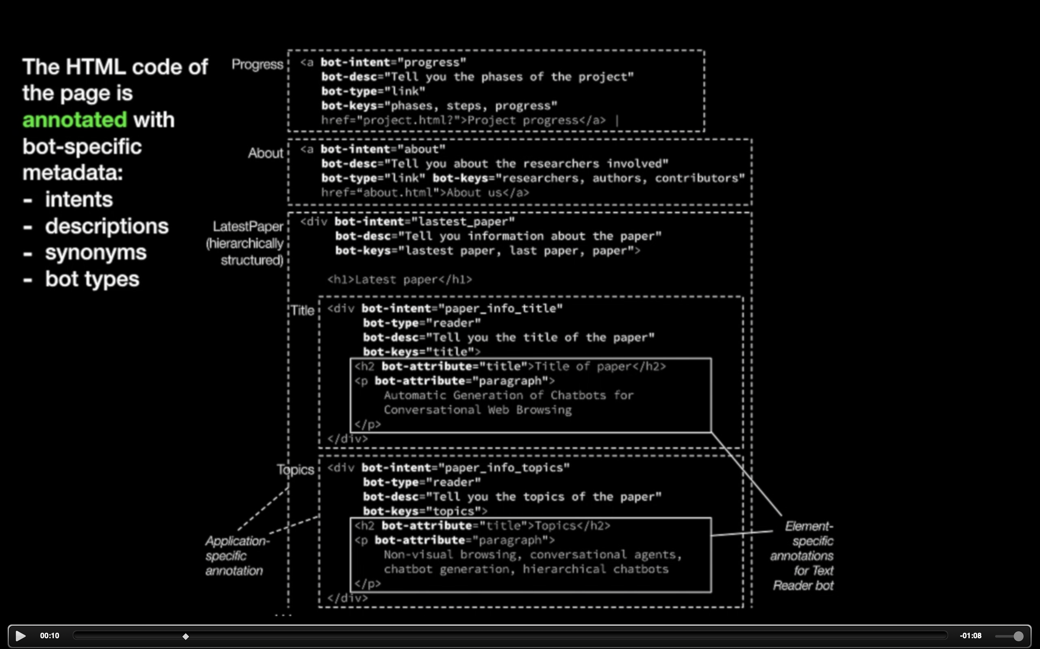
Approaches

Slide 24


Approaches
Annotation-based
conversational access to websites by enabling developers and content producers to provide appropriate annotations
Chitto’ et al., 2020
VoiceXML
Crowd-based
collaborative metadata augmentation approaches, relying on the crowd to fix accessibility problems or provide annotations for voice-based access
Takagi et al., 2008
Ripa et al. 2019
Automatic
based on heuristics and algorithms, generally focused on automatically fixing accessibility issues, deriving browsing context or predicting next user actions
Pina et al., 2020
Notes:
based on heuristics and algorithms, generally focused on automatically fixing accessibility issues, deriving browsing context or predicting next user actions.

Slide 25
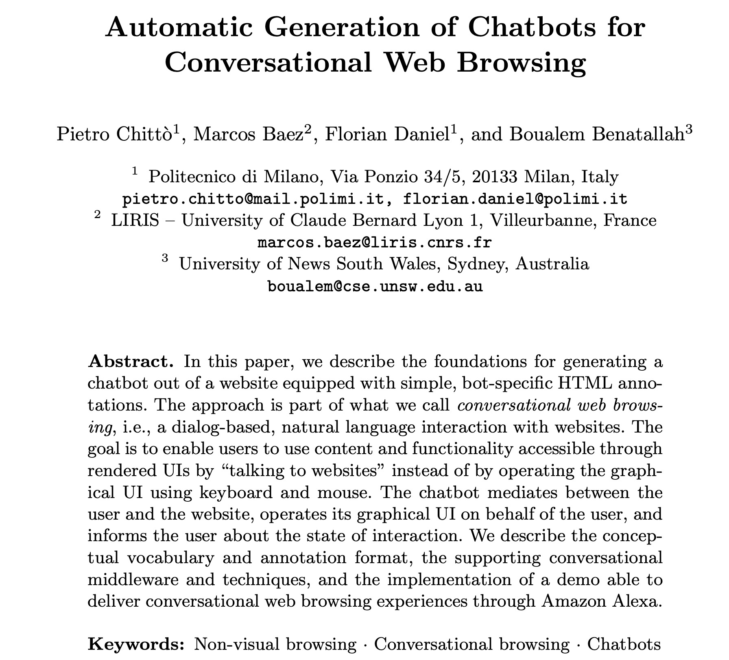
Chittò, P., Baez, M., Daniel, F., & Benatallah, B. (2020, November). Automatic Generation of Chatbots for Conversational Web Browsing. In International Conference on Conceptual Modeling (pp. 239-249). Springer, Cham.
Notes:
We provided the foundations for deriving a chatbot our of websites equipped with bot-specific annotations.
Which is based on the annotation-based approach.
Where we derived the conversational vocabulary, annotation format and also the middleware..

Slide 26
Principles
No need for custom chatbot code.
Separation of conversation model from NLU.
Presentation (NLG) managed by bot.
Web developers keep control of the experience.
Notes:
Presentation managed by the bot
we want the experience to be homogenous across websites.
and perhaps enable reusable and validated patterns

Slide 27
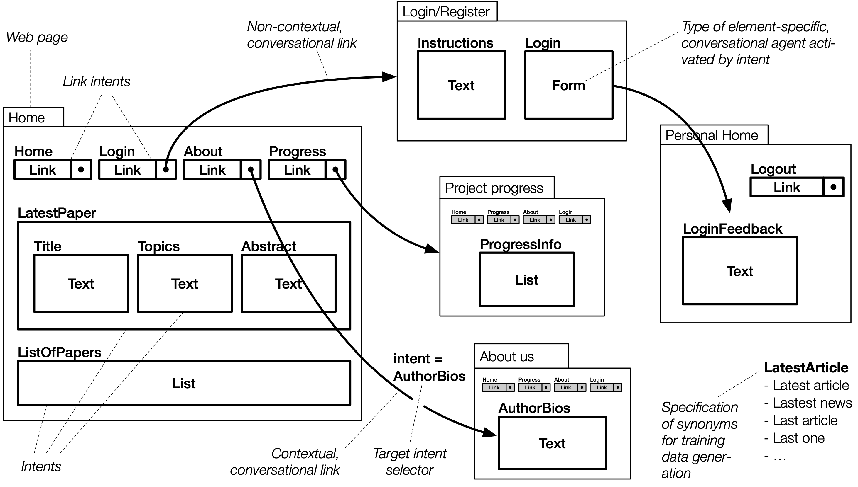
Notes:
The idea behind this is that websites already provide the ingredients for enabling conversational access. When we enter a website with a goal in mind we perform a series of actions that are available in the website, to perform fulfil our goal. In doing this we describe a workflow a user flow.
And indeed either implicitly or explicitly in their design process, web designers and developers think in terms for the user needs and how the website fulfil those needs. There are even these “user flow” diagrams that help UX designers to visualise these user flows.
How do we go from these user enacted workflows, to a conversation.
- A way to dote websites with domain knowledge

Slide 28

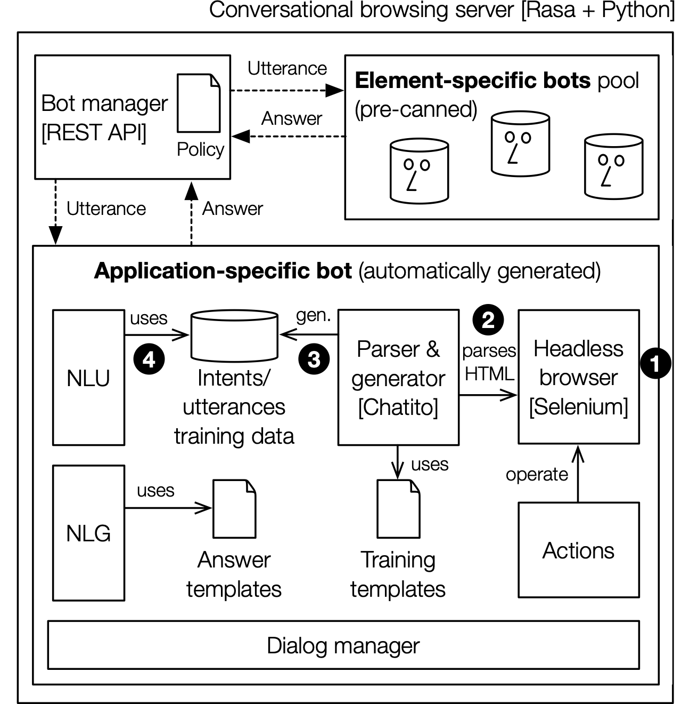
Our Approach
Home
Progress
About
Author bios
Who are the researchers involved?
Florian Daniel
Pietro Cittò
intent, slots
Marcos Baez
actions
Domain-knowledge
Interaction Knowledge
Should be provided by the developers
Should be abstracted to developers
App-specific
Element-specific
generated
pre-canned
Text Reader
List Reader
Search bot
chatbot
Notes:
At the very core, and what is driving the annotations and also the middleware, is how we deal with two important types of knowledge that are required when using a website.
First, domain knowledge refers to the knowledge that allows to understand the offerings (content and functionality) and request them. (in any type of system)
In chatbots this is related to the definition of intents, slots, utterances.
In the other hand, we have the interaction knowledge, which refers to the knowledge about the how to use and operate the website.
This would be in chatbot terms the action (or web browsing actions in our case). Meaning how to automate the interactions with the elements of the website.
With this distinction. We know that the domain-knowledge is specific to the website (the concepts such as project, publications) and should be provided by the developers. I will show an example, but this is essentially annotating HTML constructs with attributes denoting intents and some additional metadata.
While the interaction knowledge should be abstracted to the developers. How to process lists and read out paragraph - those are intents and actions that can be already provided by the system.
Indeed, what we do in the generation process is to generate the app-specific chatbot (that brings the specific intents of the website), and combined it with pre-canned bots that are provided by the system. So when the user provides a request, we have a policy in place for selecting the appropriate underlying bot to serve the request..

Slide 29
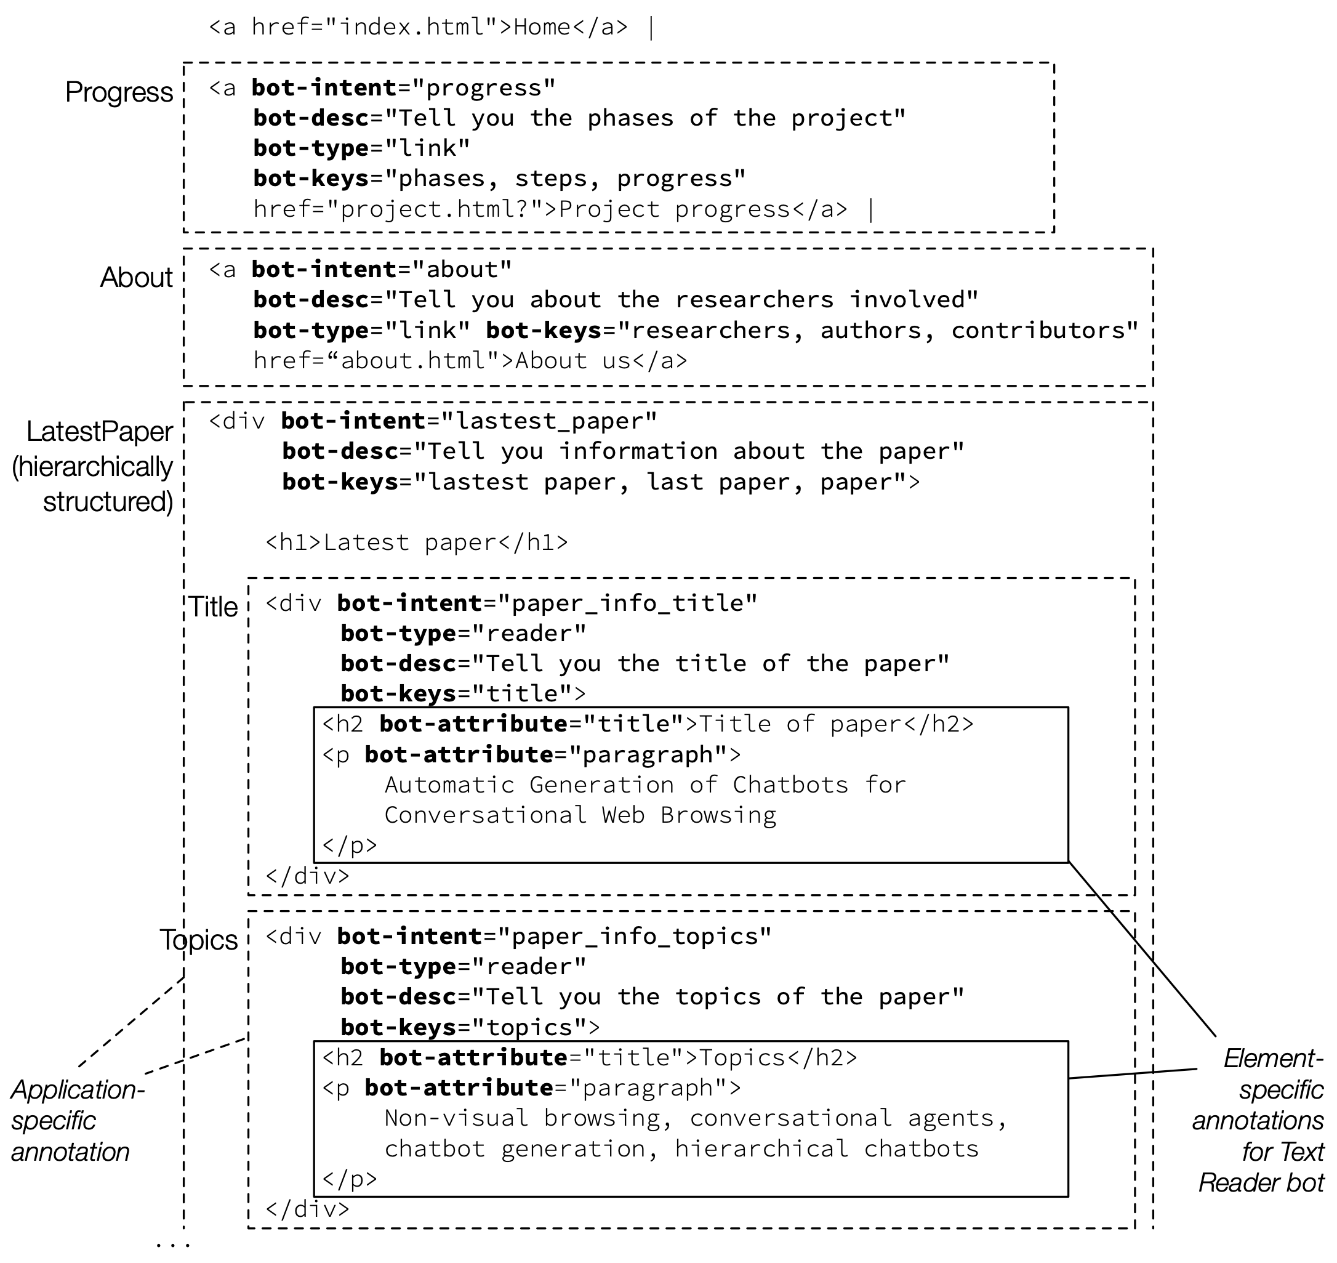
Natural language dialog
Link
Site opened. In this website I can:
Tell you the about its progress
Tell you about the researchers
Tell you about the latest paper
Tell me about the latest paper
Ok, getting project information:
A
B
Title of the paper
Topics of the paper
A
Tell me the title
Title of the paper:
Reading
Reading
Automatic Generation of Chatbot for Conversational Web Browsing
B

Slide 30
Demo

Slide 31
Architecture
Conversational browsing server
[Rasa + Python]
Annotated Website
Natural language dialog
Home
Progress
About
Project info
Site opened. In this website I can:
Tell you the about its progress
Tell you about the researchers
Tell you about the latest paper
The conversational web browsing project aims at…
News
Latest paper
Tell me about the latest paper
Title
Topics
Abstract
List of papers
Ok, getting project information:
Alexa Voice Service
A
B
Title of the paper
Topics of the paper
Home
Progress
About
Author bios
Tell me the title
Florian Daniel
Title of the paper:
Pietro Cittò
Reading
Marcos Baez
Automatic Generation of Chatbot for Conversational Web Browsing
Automated web browsing actions
Audio
Text

Slide 32
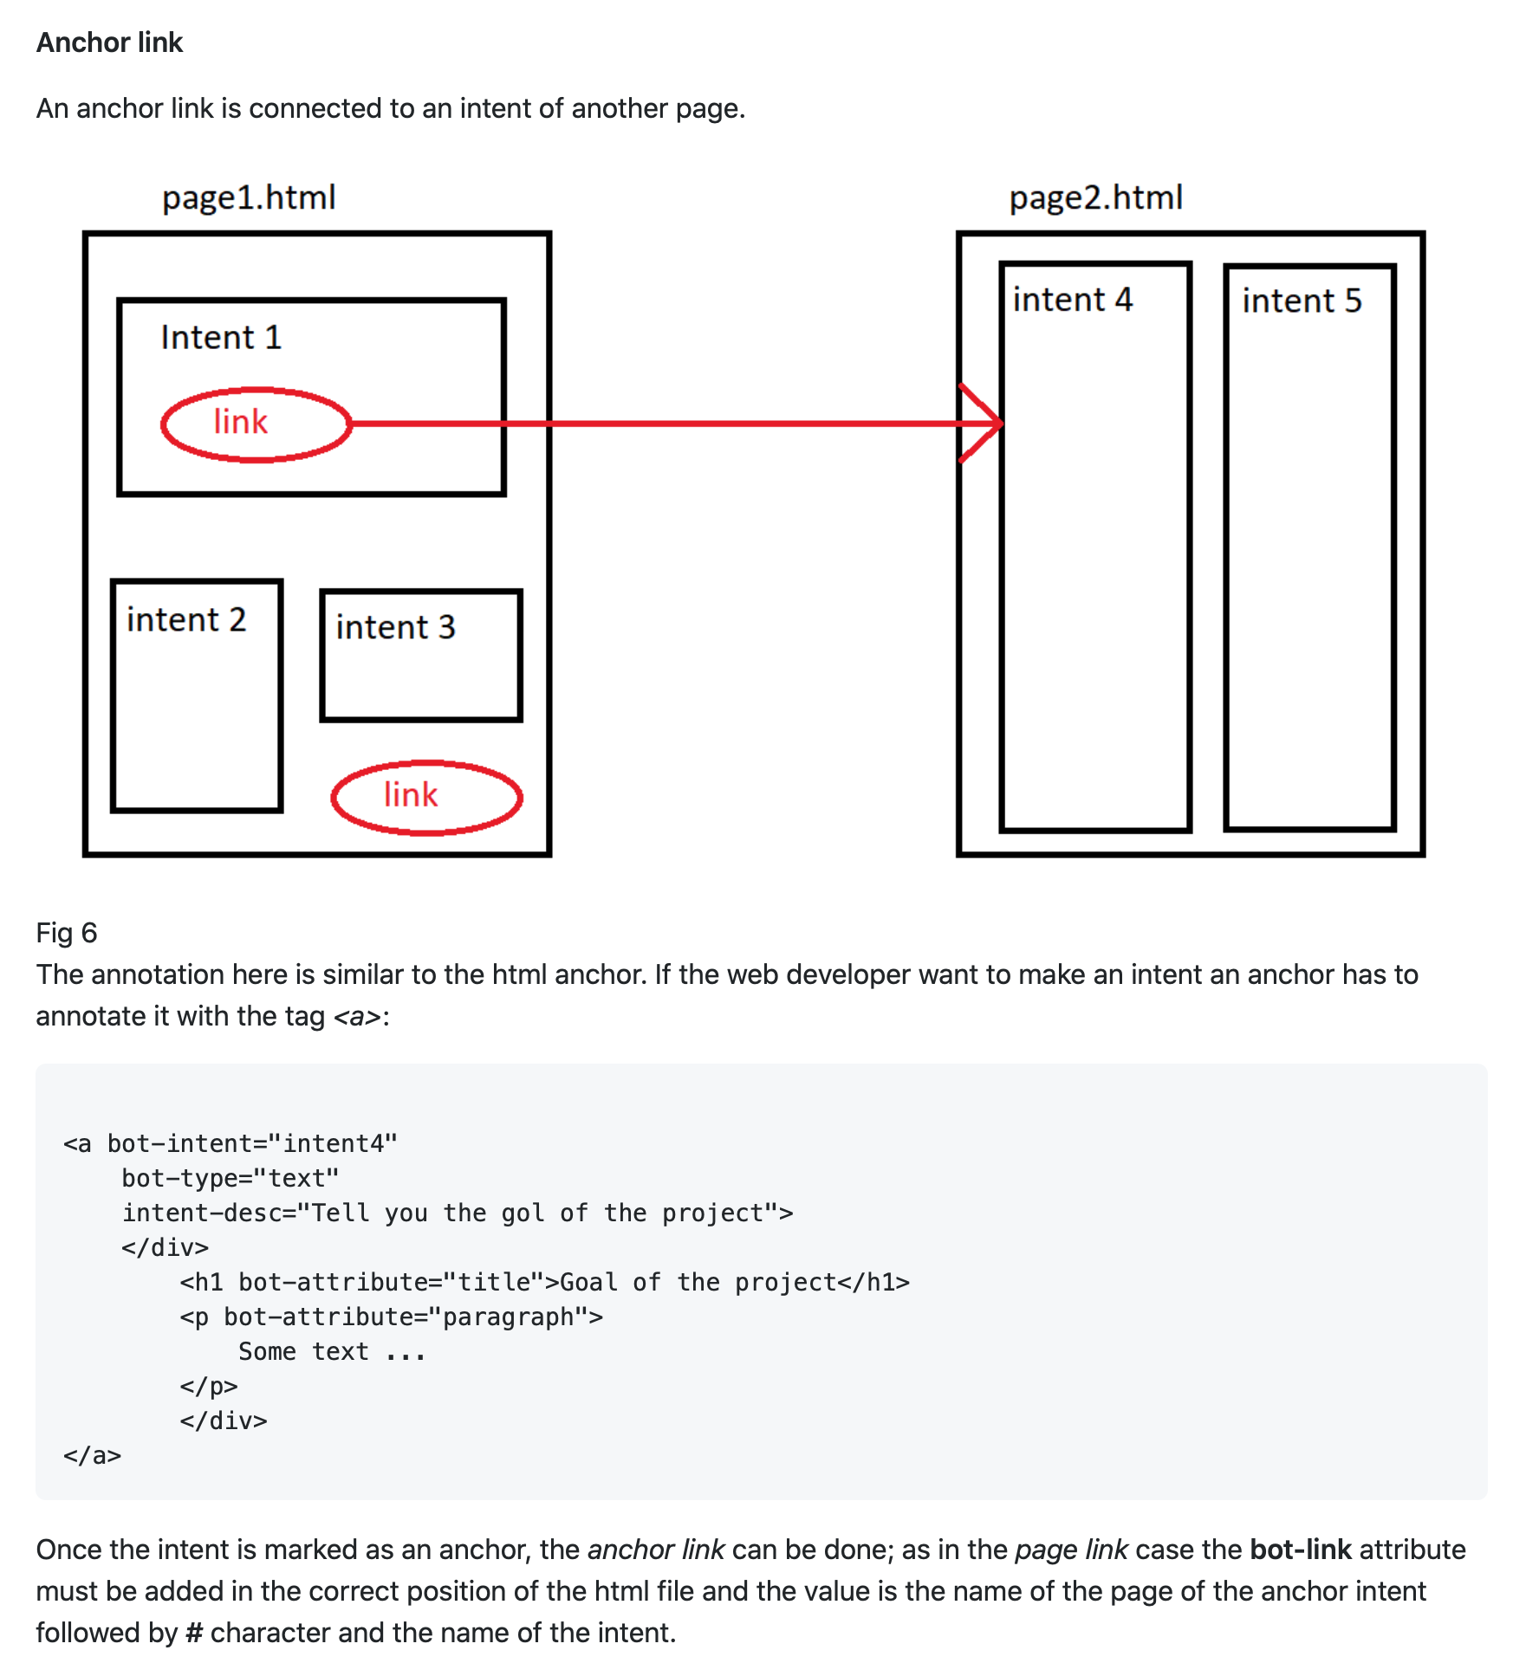
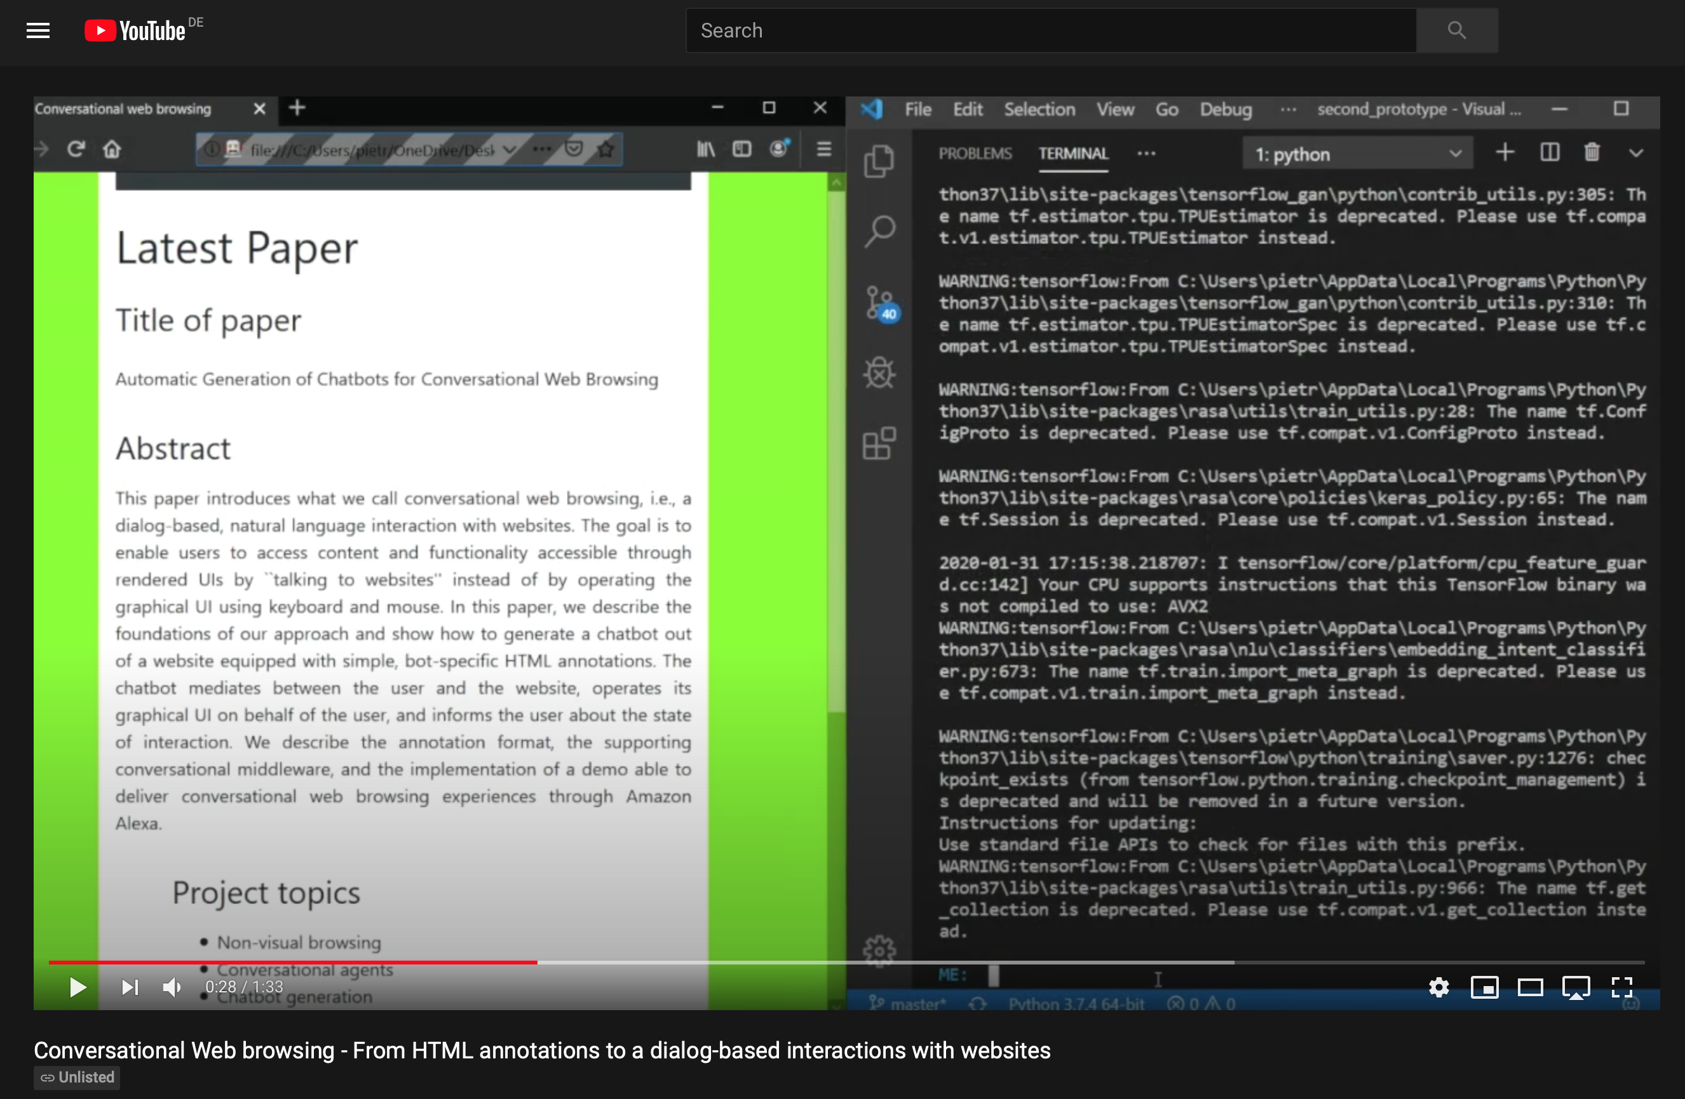
Demo
Repo
https://cutt.ly/conweb-demo
https://github.com/floriandanielit/conversationalweb
Notes:
I also invite you to check out our demo

Slide 33
Publications on Conversational Browsing and Infrastructure
Baez, M., Daniel, F., & Casati, F. (2019, November). Conversational web interaction: proposal of a dialog-based natural language interaction paradigm for the web. In International Workshop on Chatbot Research and Design (pp. 94-110). Springer, Cham.
Baez, M., Daniel, F., Casati, F., & Benatallah, B. (2020). Chatbot integration in few patterns. IEEE Internet Computing.
Chittò, P., Baez, M., Daniel, F., & Benatallah, B. (2020, November). Automatic Generation of Chatbots for Conversational Web Browsing. In International Conference on Conceptual Modeling (pp. 239-249). Springer, Cham.
Pina, Alessandro, Marcos Baez, and Florian Daniel. "Bringing Cognitive Augmentation to Web Browsing Accessibility." arXiv preprint arXiv:2012.03743 (2020).
Barukh, M. C., Zamanirad, S., Baez, M., Beheshti, A., Benatallah, B., Casati, F., ... & Schiliro, F. Cognitive augmentation in processes. Next-Generation Digital Services-Essays Dedicated to Mike Papazoglou, 12.
Bouguelia, S., Brabra, H., Zamanirad, S., Benatallah, B., Baez, M., Kheddouci H. Reusable Abstractions and Patterns for Recognising compositional conversational flows. CAiSE 2021

Slide 34
Thanks!
MARCOS BAEZ
marcos.baez@liris.cnrs.fr

